Slide 1

Welcome to English lessons!
Đỗ Phan Nhã An

Slide 2
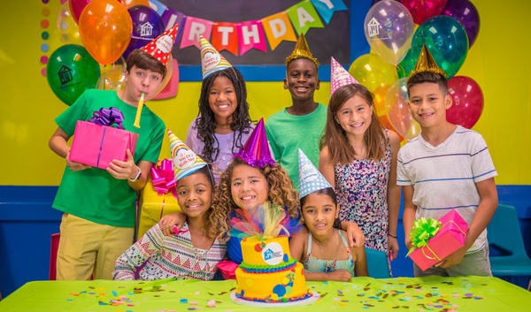
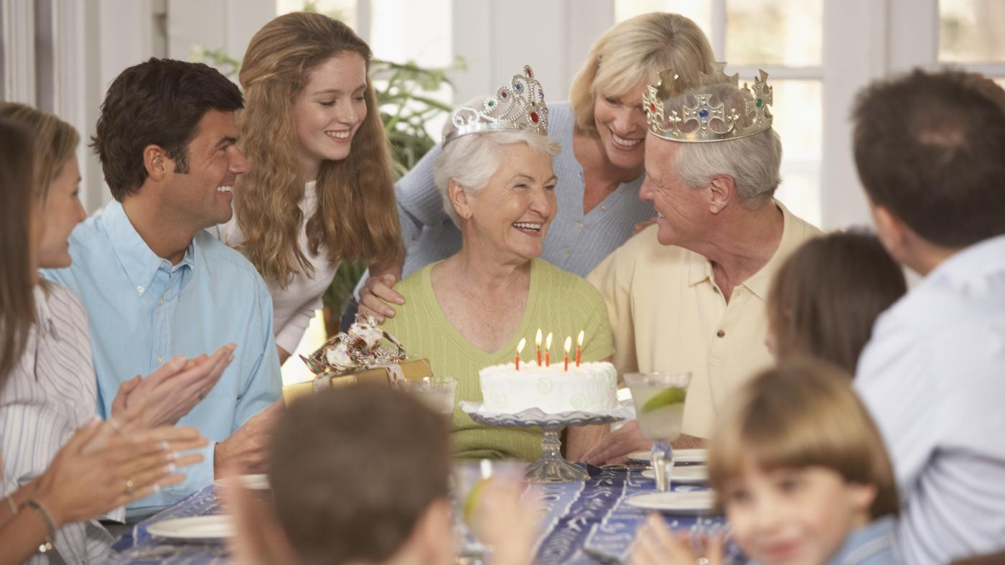
What do the pictures show?
A party

Slide 3
Unit 3: A PARTY
A. Reading

Slide 4
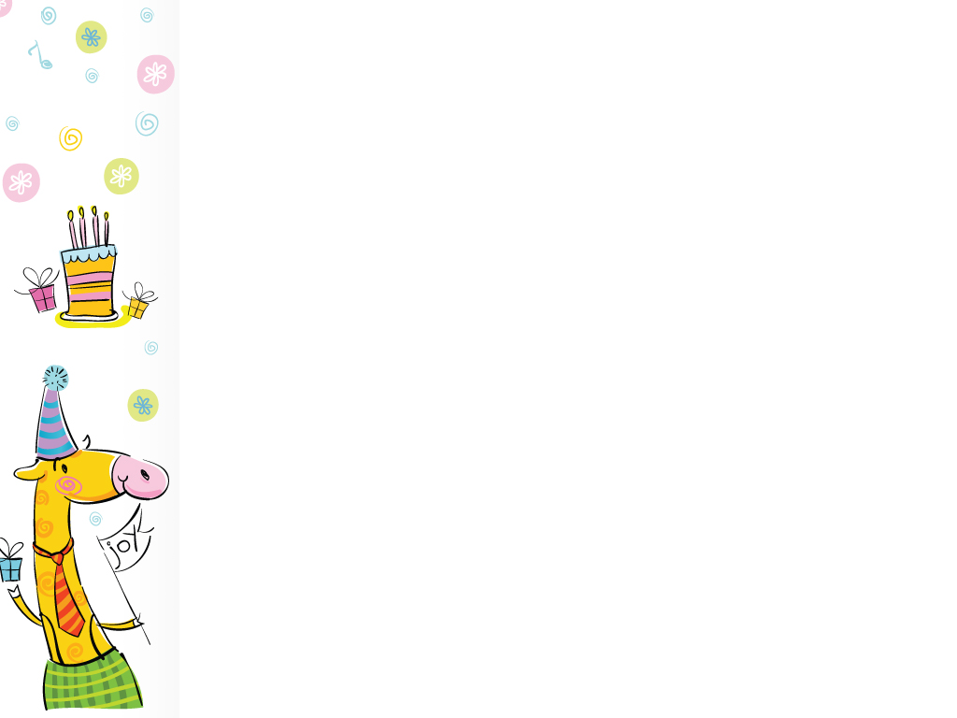
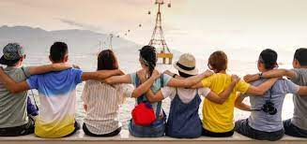
relationship (n) /rɪˈleɪʃənʃɪp/
Vocabulary
Ex: - What is the relationship between them?
- Friendship.
relate (v)
relation (n)
relative (n)

Slide 5
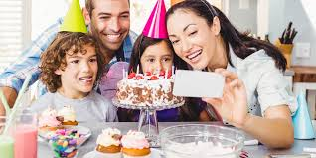
celebrate (v) /ˈselɪbreɪt/
Vocabulary
Ex: The family is celebrating a birthday.
celebration (n)

Slide 6
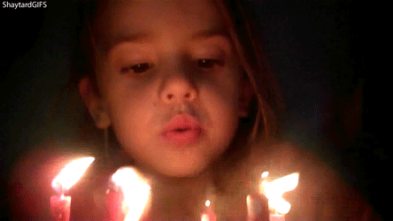
blow out (v) /bləʊ aʊt/
Vocabulary
candle(n) /ˈkændl/
Ex: The girl is blowing out the candles.

Slide 7
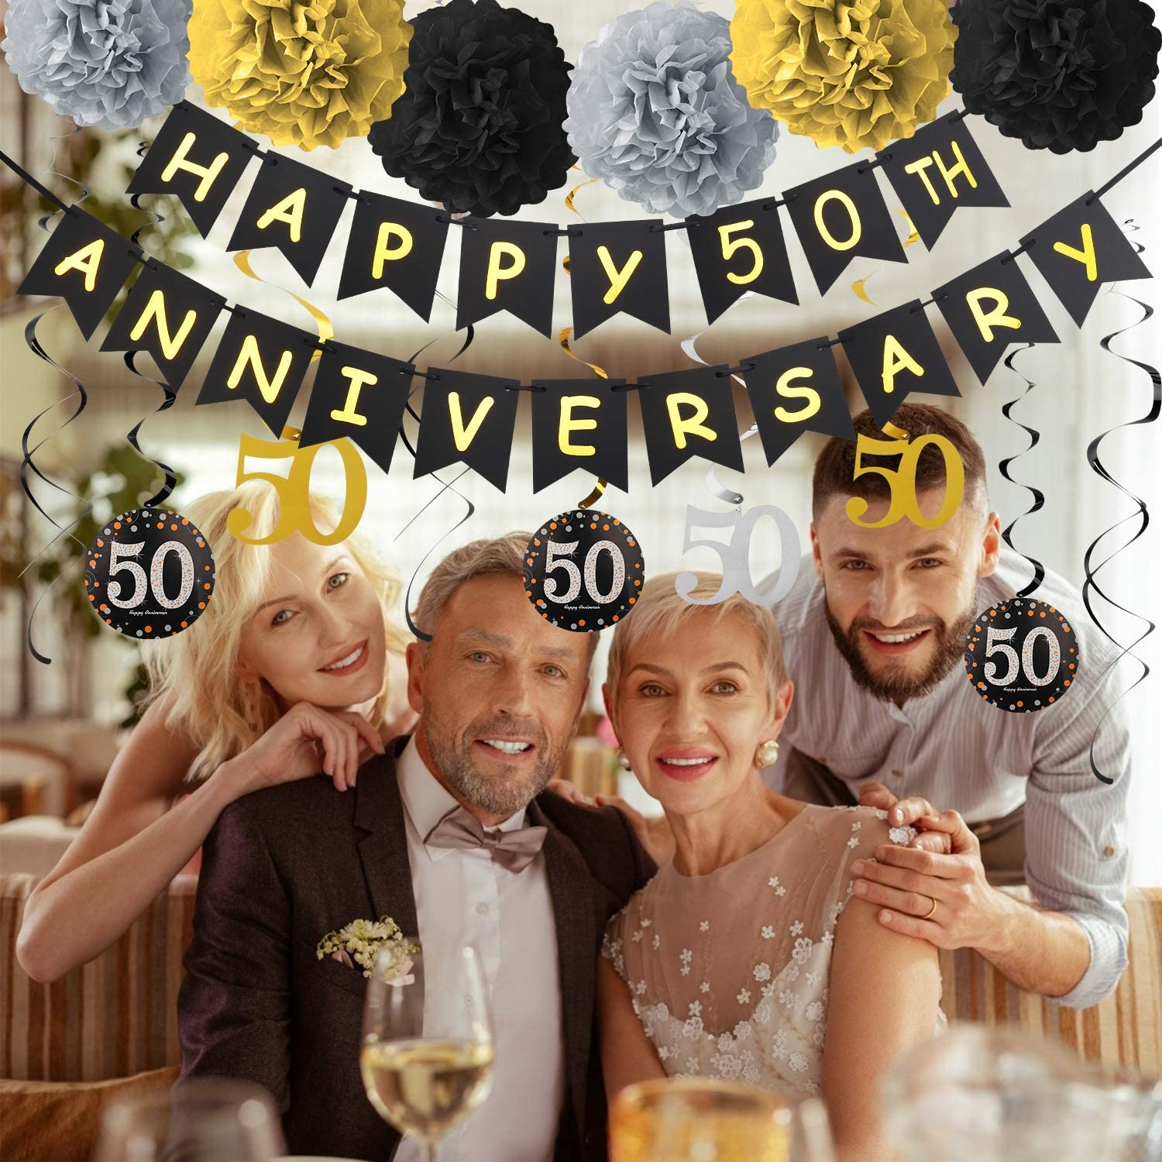
anniversary (n) /ˌænɪˈvɜːsəri/
Vocabulary
Ex: They are going to have a party to celebrate their 50th wedding anniversary.

Slide 8
milestone (n) /ˈmaɪlstəʊn/
Vocabulary
Ex: The 50th anniversary marked an important milestone in their marriage.

Slide 9
Vocabulary
relationship (n)
  relate (v)
  relation (n)
  relative (n)
celebrate (v)
  celebration (n)
blow out (v)
candle (n)
anniversary (n)
milestone (n)

Slide 10
Reading passage
1
5
8
12
16

Slide 11
Reading passage
1
6
10
14

Slide 12
Decide which of the activities below takes place at a birthday party or at a wedding anniversary party or at both. Put a tick (✓) in the right box.
Task 1
 | BIRTHDAY PARTY | WEDDING ANNIVERSARY PARTY | EVIDENCE Part (Lines)
1. People sing a song.
2. People eat cake.
3. People receive cards and gifts from friends and relatives.
4. People joke about their age.
5. People remember their wedding day.
6. People go out to dinner.
7. People blow out candles, one for each year.
✓
P. A (L. 3-8)
P. A (L. 9)
P. B (L. 3-4)
✓
✓
P. A (L. 9-10)
P. B (L. 4-5)
✓
✓
✓
P. A (L. 15)
✓
P. B (L. 6-7)
✓
P. B (L. 8)
✓
P. A (L. 2-3)

Slide 13
In each of the following sentences, there is ONE word which is not true according to the reading passage. Underline the wrong word and provide the correct one.
Task 2
 | EVIDENCE Part (Lines)
1. Lisa's family and friends are at her eighth birthday party.
2. Everyone makes cake and ice cream at the birthday party.
3. Lisa opens birthday cards and books from her family and friends.
4. Many Americans over the age of 30 don't like to talk about their anniversaries.
5. Fifty months ago, Rosa and Luis got married.
6. People call the 5th wedding anniversary the "golden anniversary."
7. Rosa and Luis are happy to be together for their silver anniversary.
P. A (L. 1)
seventh
P. A (L. 9)
eats
presents/gifts
P. A (L. 9-10)
P. A (L. 14-15)
age
years
P. B (L. 2)
P. B (L. 11)
50th
P. A (L. 13-14)
golden

Slide 14
Unit 3: A PARTY
C. Listening

Slide 15
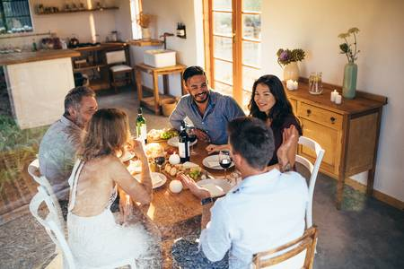
gather (v) /ˈɡæðə/
Vocabulary
Ex: We gathered in the dining room for the dinner.

Slide 16
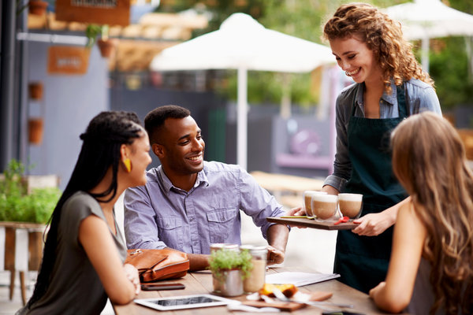
serve (v) /sɜːv/
Vocabulary
server (n)
service (n)
Ex: The server is serving some drinks.

Slide 17
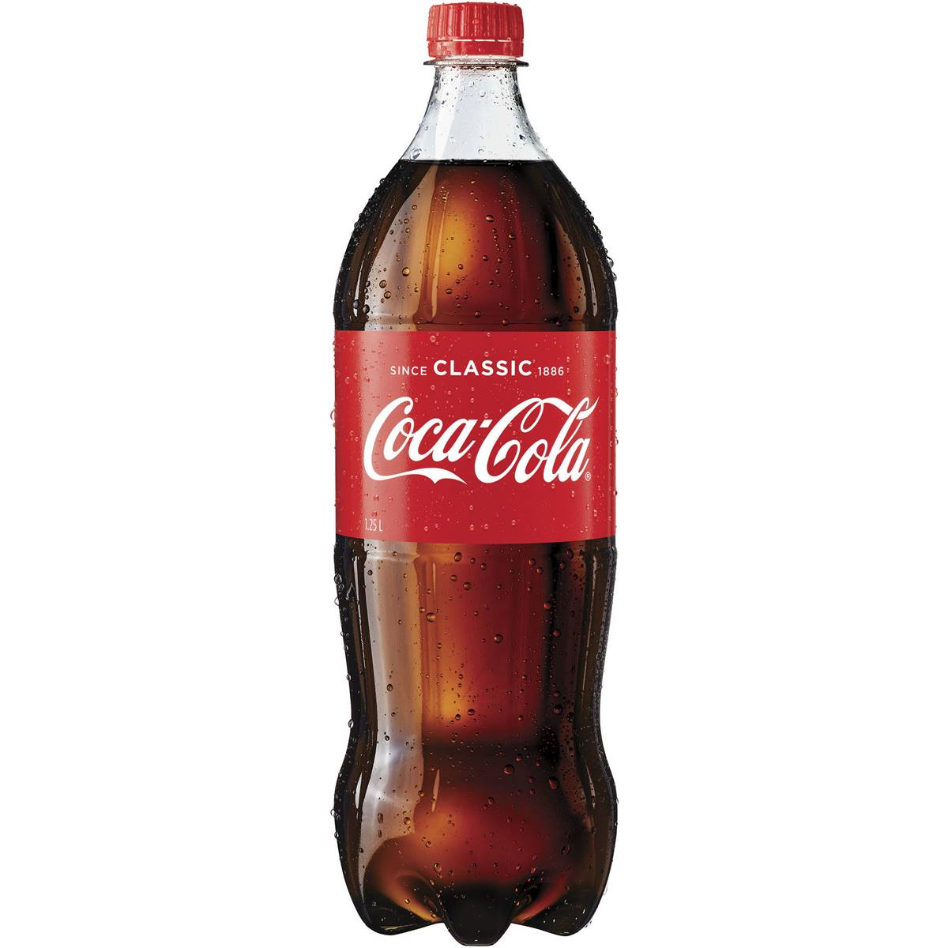
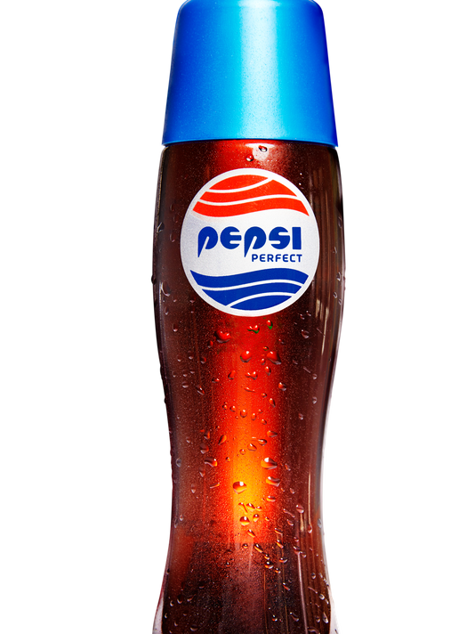
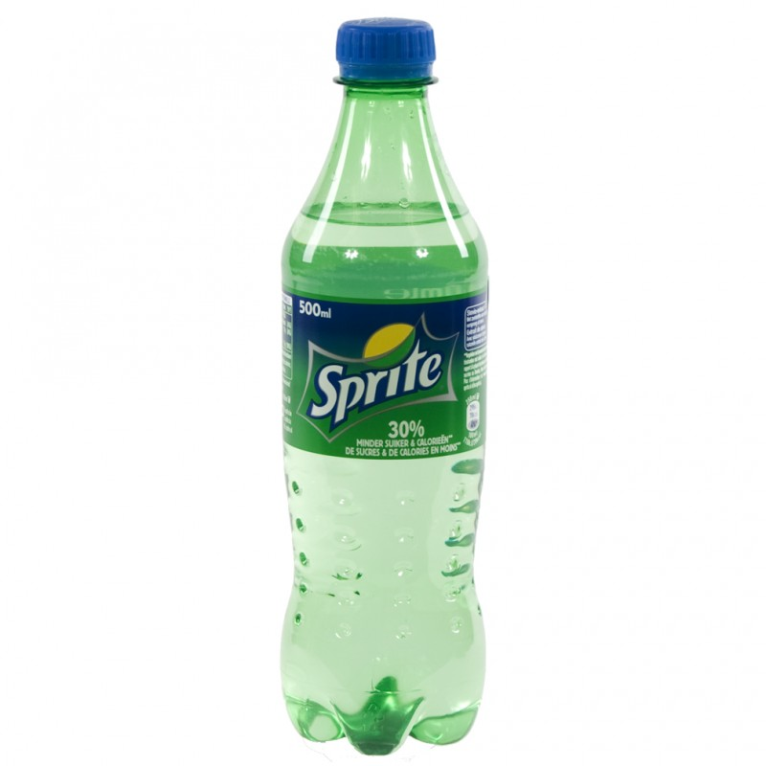
soft drink (n) /ˌsɒftˈdrɪŋk/
Vocabulary
Ex: My cousins like soft drinks a lot.

Slide 18
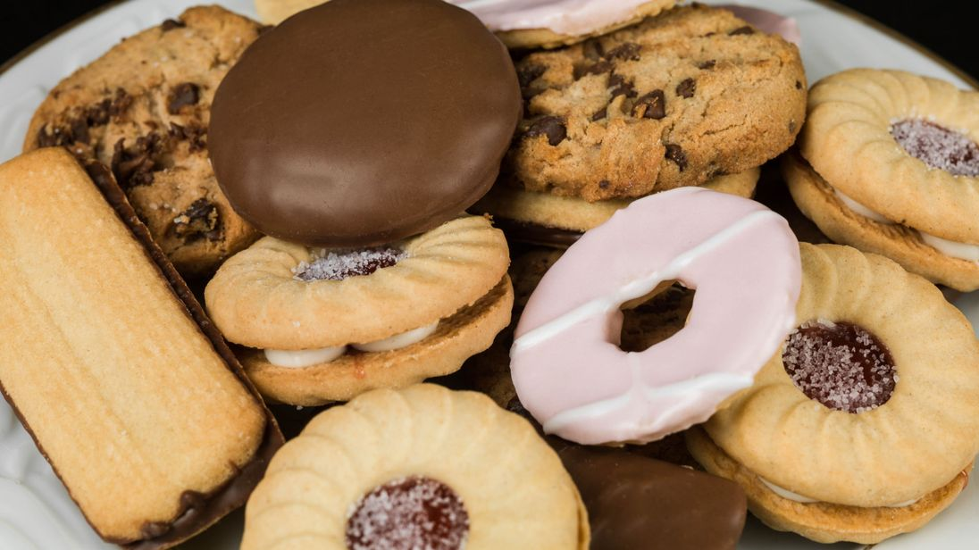
Vocabulary
/ˈbɪskɪt/
biscuit (n)
Ex: Children love biscuits.

Slide 19
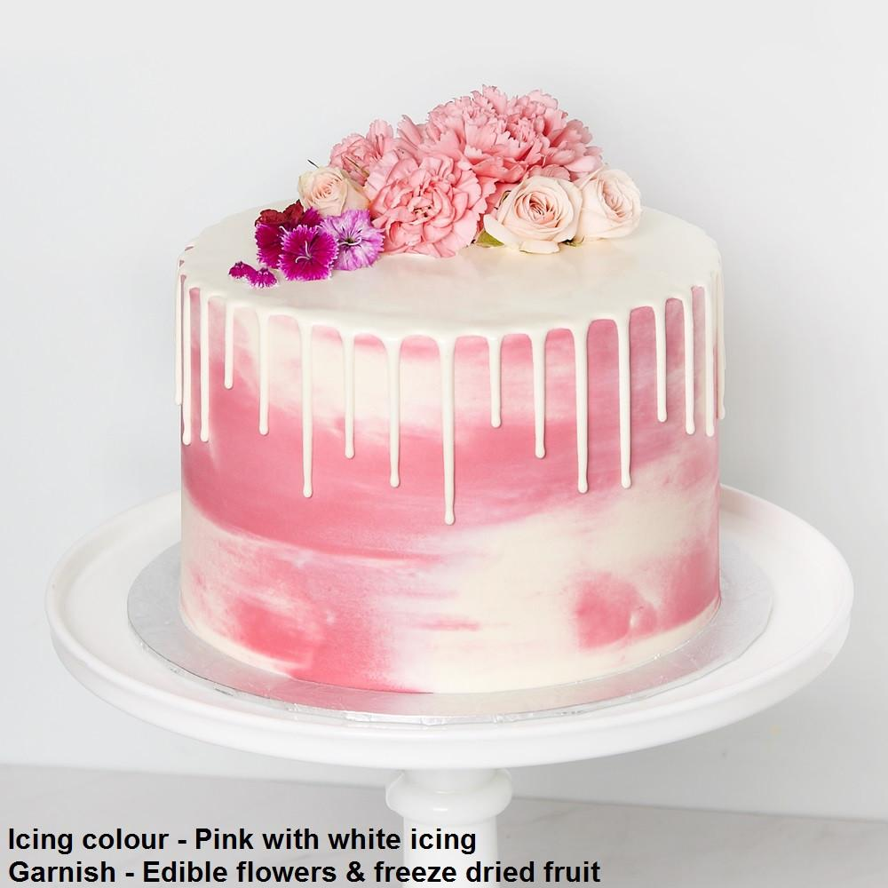
/ˈaɪsɪŋ/ icing (n)
Vocabulary
Ex: The cake was beautifully decorated with pink and white icing.

Slide 20
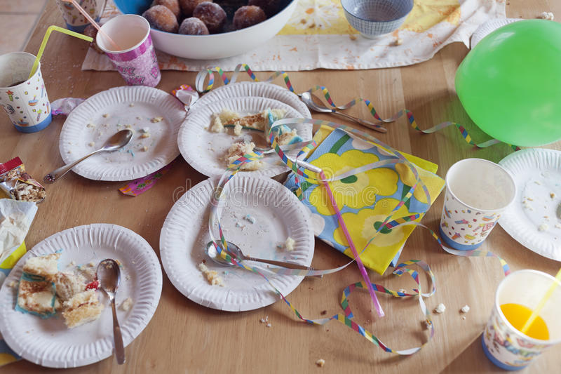
mess(n) /mes/
Vocabulary
messy (adj)
Ex: After the party, we helped her to clean up the mess.

Slide 21
Vocabulary
gather (v)
serve (v)
  server (n)
  service (n)
soft drink (n)
biscuit (n)
icing (n)
mess (n)
  messy (adj)

Slide 22

Decide whether the statements are True or False
 | Statements | T | F
1 | Mai’s birthday party was held at home in the evening.
2 | Over twenty guests were at the birthday party.
3 | The birthday cake was cut at the beginning of the party.
4 | The birthday party lasted about three hours.
5 | All the friends stayed after the party to tidy up the mess.
✓
afternoon
✓
About
✓
in the middle
✓
✓
The speaker

Slide 23
Answer the questions
1. How old was Mai?
2. Why didn’t she like having her party at the restaurant?
3. What did Mai’s mother serve at the beginning of the party?
4. What was the birthday cake like?
5. What did all the guests do while Mai was cutting the cake?
6. How did the other children get home?

Slide 24
1. How old was Mai?
→ 16 years old
2. Why didn’t she like having her party at the restaurant?
→ Because it’s noisy and expensive.

Slide 25
3. What did Mai’s mother serve at the beginning of the party?
→ Soft drink and biscuits
4. What was the birthday cake like?
→ It was beautifully decorated with pink and white icing.

Slide 26
5. What did all the guests do while Mai was cutting the cake?
→ They clapped their hands and sang “Happy birthday”.
6. How did the other children get home?
→ Their parents collected them by motorbike.

Slide 27
Homework
Learn vocabulary
Prepare for the next lesson

Slide 28
THANKS FOR YOUR ATTENTION!

